Slide 1
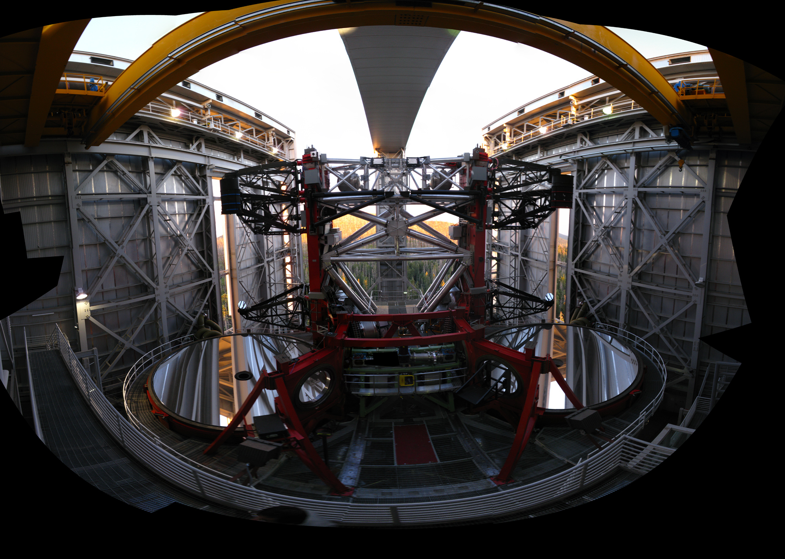


NGC 2273 with AO @ LBT: results, issues and perspectives
C. Arcidiacono
R. Fanali
E. Pinna, K Boutsia, L. Busoni, F. Mannucci, F. Quiros-Pacheco, A. Puglisi, F. Quiros-Pacheco, G. Risaliti, A. Marconi, M. Salvati, D. McCarthy
Eleonora Sani – AGN11 Trieste – 23 Sep 2014

Slide 2
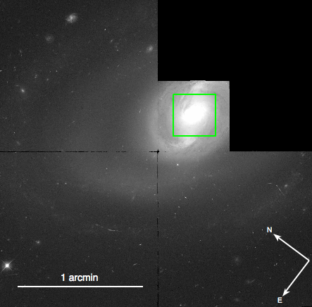
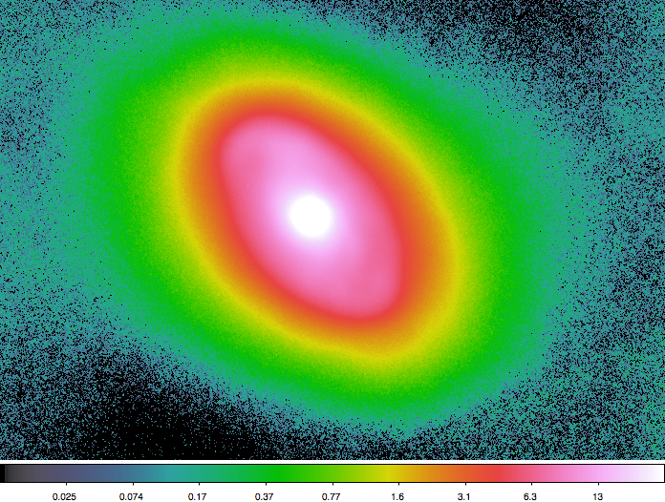
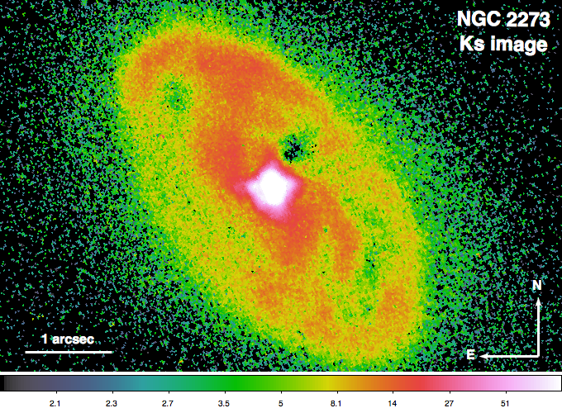
NGC 2273 AO imaging: PISCES@LBT
Lack of multi-band imaging → No dusty structures morphology
R+I = 15.5+15.0
+ → poor SR
Seeing ~ 1”
Still enough to detect 3m-spirals

Slide 3
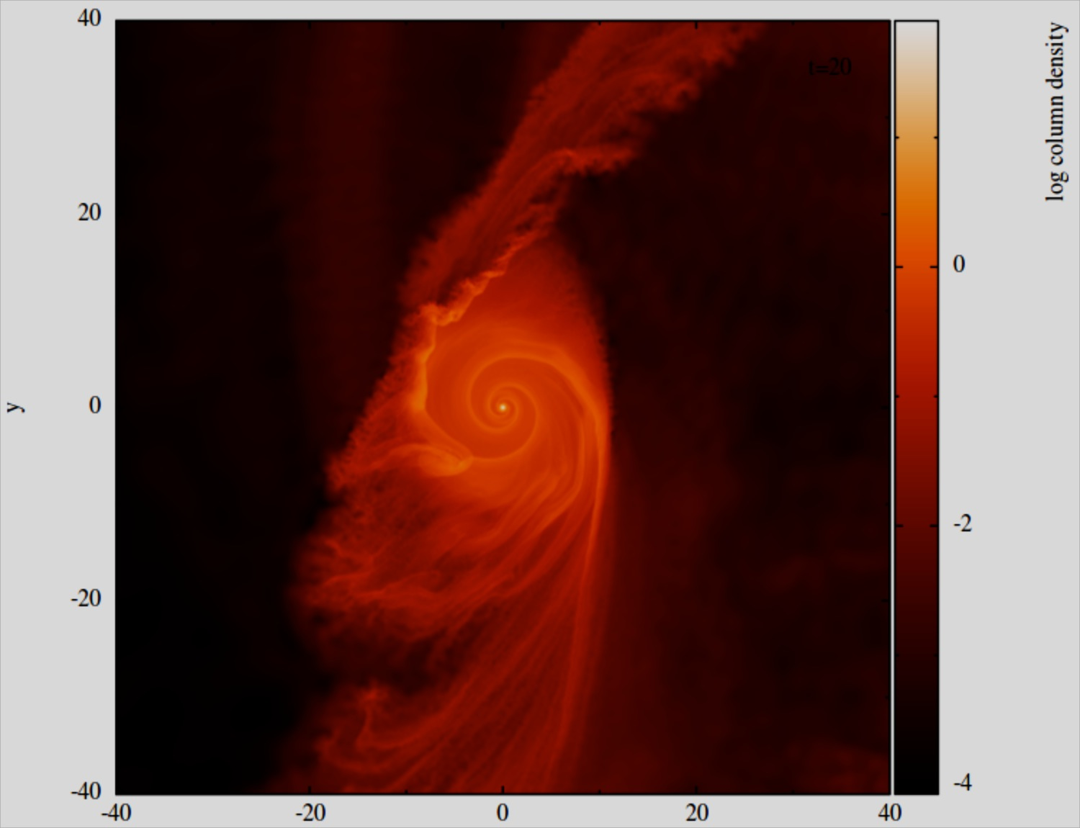
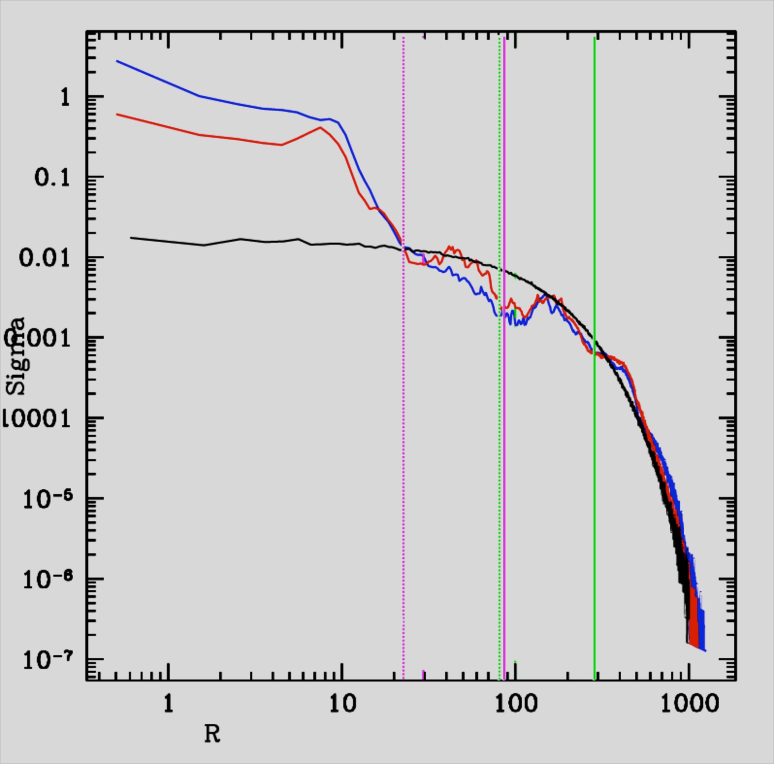
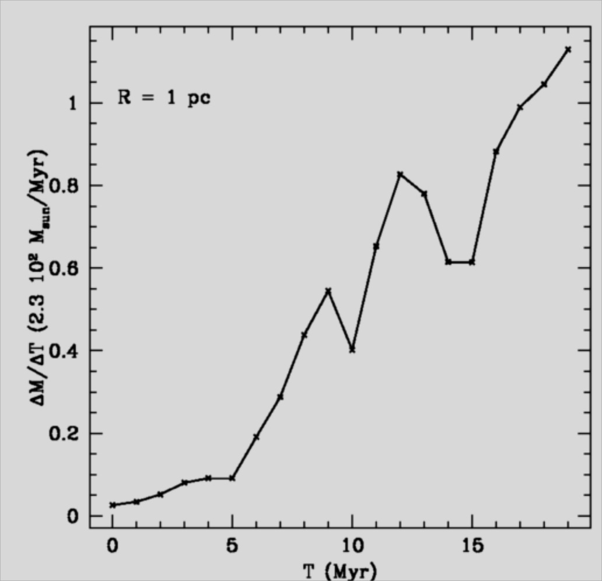
NGC 2273: simulations
Gaseous disk
Exponential density profile
M_{disk} = 23*10⁷ M_{sun}
R = 100 pc
z = 30 pc
(Sani +12, PdBI data)
SB(r)a morphology
GADGET2 (Springel +05)
Static axisymmetric potential from SIS
Implements weak perturbations
Φ_{b} = ε(r) Φ(R) cos2(ϑ-Ω_{b}t)
Evolution 40 Myr
Double bar Ω_{b1}/Ω_{b2}=3 (resonances)
Log Column Density
ΔM/ΔT (0.23 M/yr)
T₀
T₁= 10 Myr
T₂= 20 Myr
R. Fanali PhD thesis
Notes:
We use our previous measurements from PdBI tu run numerical simulations able to reproduce the observed 3m-spirals and thus study the kinematics and disk evolution
The system is a galactic disk which follows an Exp density profile characterized by… We assume the system in a Static axisymmetric potential driven by a Singular Isothermal Sphere density profile.
We allow the system to evolve by implementing a week perturbed gravitational potential. This pot. is time dependent and permits the formation of a bar/ring with the consequent development of spiral arms. EX: a double bar system, characterized by resonances…

Slide 4
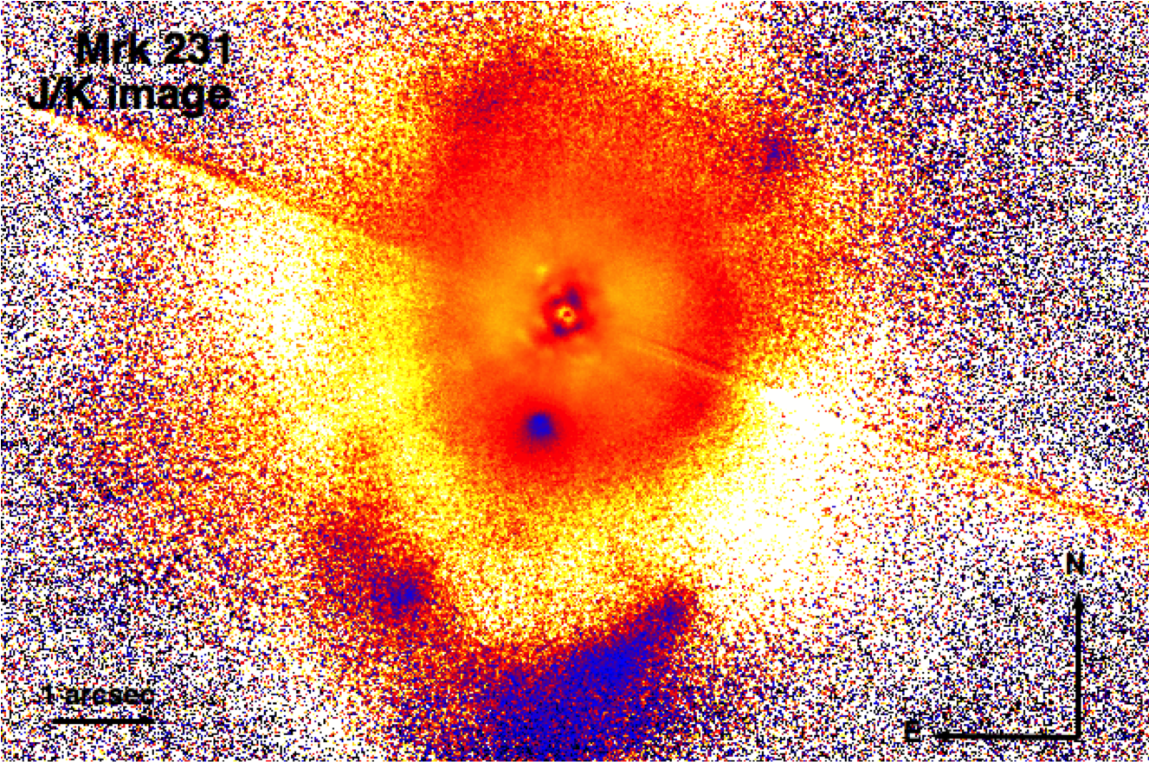
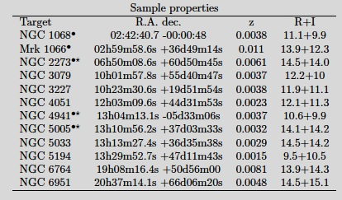
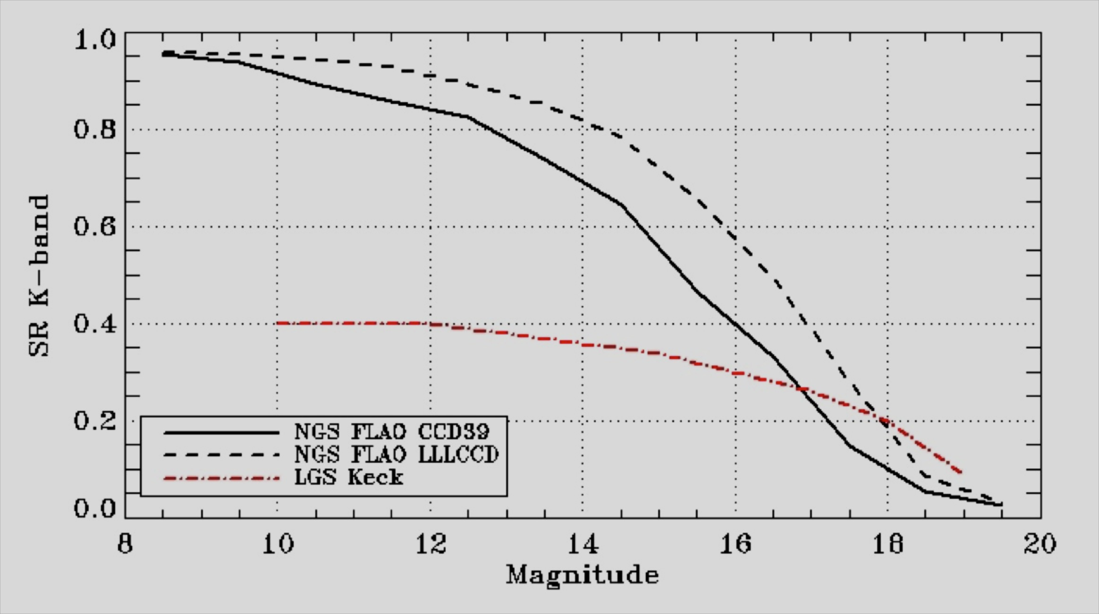
Extragalactic science with SOUL
Extragalactic science with FLAO
NGC 1068, NGC 4951, IRAS 05189-2524, Arp 220
Single conjugated adaptive Optic
Upgrade for LBT
Mrk 231 J-K color map PISCES+FLAO
(Bongiorno et al. in prep)
AGN-related topics:
Feeding/feedback processes at low-z
AGN close pairs (useful byproduct)
QSO host galaxies at high-z
DLA systems
SOUL
ESO, Keck
Notes:
At a given mag improve the SR (thus also PSF/resolution and contrast), extend to 650nm, a much larger skycoverage

Slide 5
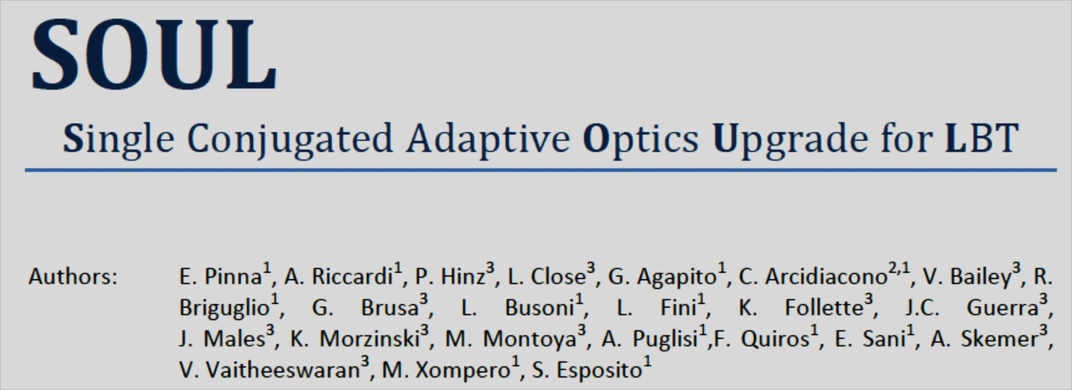
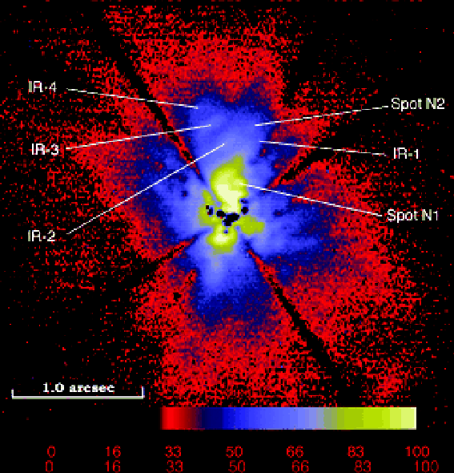

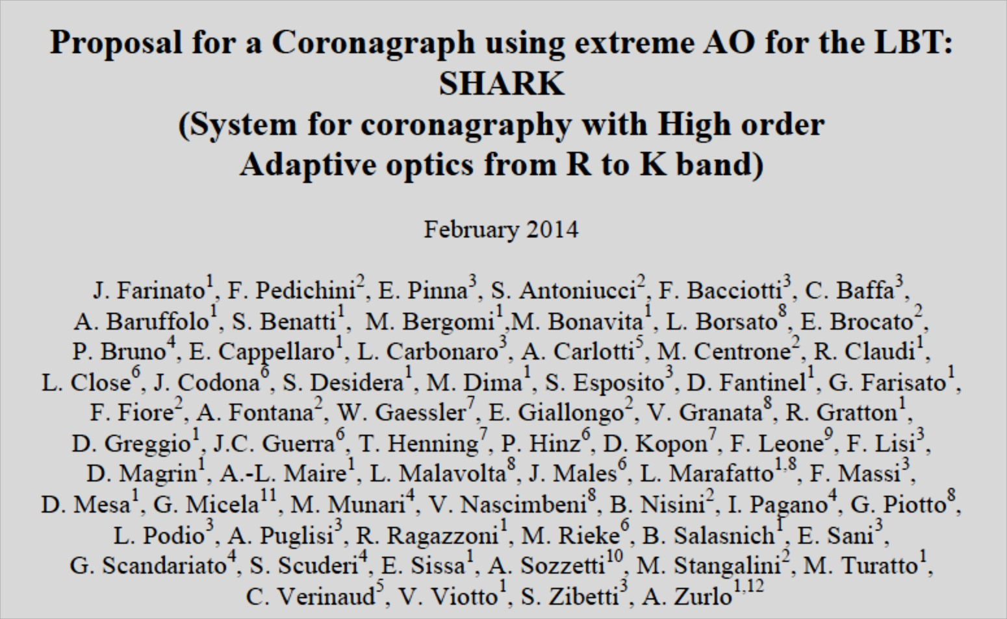
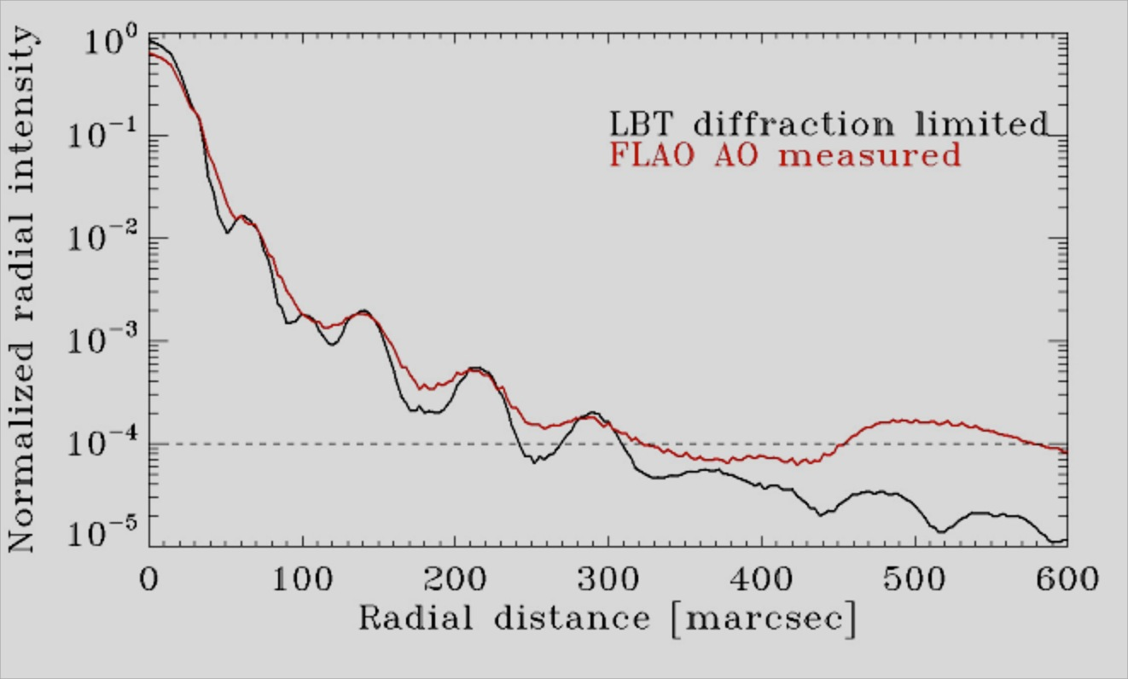
Extragalactic science with SOUL+SHARK
System for coronagraphy with High order Adaptive optics from R to K
Pyramid WFS
Pyramid WFS
NACO ADI of NGC 1068
(Gratadour et al. 2005)
Adaptive secondary
Adaptive secondary
SHARK
Vis
R; I
SHARK
NIR
J; H; K
LMIRCam
L; M
Vis
IFU

