Slide 1
On the size evolution of early type galaxies and their dark matter haloes
Gian Luigi Granato
INAF – Trieste
Cinthia Ragone-Figueroa
Mario Abadi
IATE-Cordoba
Plan:
Generalities on the problem
Why puffing-up cannot explain what we see so far
But we could see in the future
Implications for DMH profiles

Slide 2
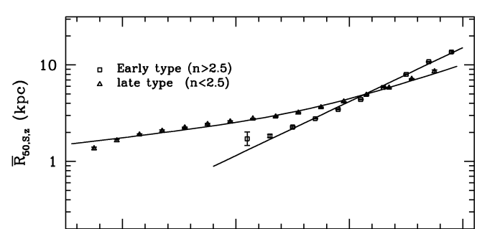

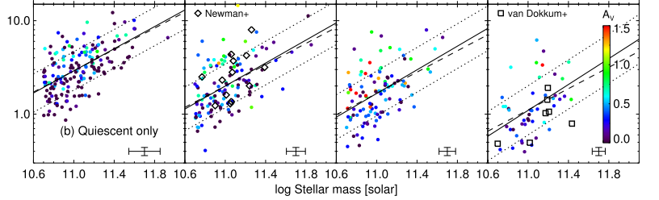

Observed evolution of the size-mass relationship since z»2.5
For ETG @z=0 R_{e}' 2.9e-6 (M/M¯)^{0.56} Kpc
Shen et al 2003
Newman + 2011
Normalization decreases by a factor a 3-5
Supposed to provide clues on mass assembly mechanisms
Notes:
This study was inspired by one of the proposed explanations for the observed evolution of the size-mass relationship since z \sim 2.5.
The basic observational facts, now confirmed by dozens of papers, are summarized here.

Slide 3
Proposed explanations for size evolution
Many minor dry mergers, wherein R / M² (maybe optimistic). Promising, but maybe cannot account for all (Hopkins et al 2010), particularly at z>1 (Newman et al 2011);
“Puffing up”: “Gravity loss” due to expulsion of baryonic mass by galactic winds (AGN and/or SNae driven) or/and stellar evolution (Fan et al 2008,2010; Damjanov et al 2009);

Slide 4
Puffing up by expulsion of baryonic mass
Suggestion made originally (Fan et al 2008) in the context of a specific SAM for SMBH-spheroid co-evolution (Granato et al 2004)
But VERY general: independently of still unclear “details” of formation mechanism of ETGs, very likely they underwent, at some point over their history, important (» 50%) ejection of baryonic matter.
Actually, virtually all realistic galaxy formation models include
  Prompt early galactic winds driven by AGN and/or SNae
  Later mass loss due to stellar evolution

Slide 5
To cast light, idealized numerical simulations
We investigate the evolution of spheroidal distributions of collision-less particles, comprising two components (stars and DM), during and after a change of potential due to a loss of baryonic mass, either residual gas or the mass lost from stars.
MassLoss(t) is given, due to causes whose physics is not treated (feedbacks, or stellar evo).
We don’t have to treat gas dynamics since we investigate the behavior of collision-less components (stars and DM) : simple N-body simulations.

Slide 6
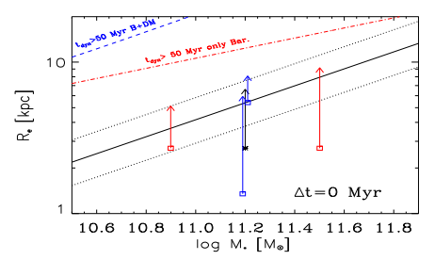
Numerical technique and setup
Initial conditions thought to get a final configuration, after the loss of 20-80% of baryons, consistent with our basic knowledge of the properties of local large ETGs (baryon to DM mass ratio, scale-lengths, size as a function of stellar mass):
(NFW profile for DM (R_{vir}=170 Kpc, c=4, with and without adiabatic contraction before mass loss, Hernquist profile for baryons (R_{e}=2.7 Kpc). Equilibrium σ² solving Jeans equation. M_{vir}=1e13; M_{vir}/M_{B}(t=0)=25.)
Impose exponential loss of a fraction (1-ε) of baryonic mass, over a time scale Δt:
Practically attained decreasing in time the mass of baryon particles
Δt=0, 2, 5, 20, 80 Myr (t_{dyn} ' 5 Myr)
ε=0.2,0.4,0.6,0.8

Slide 7
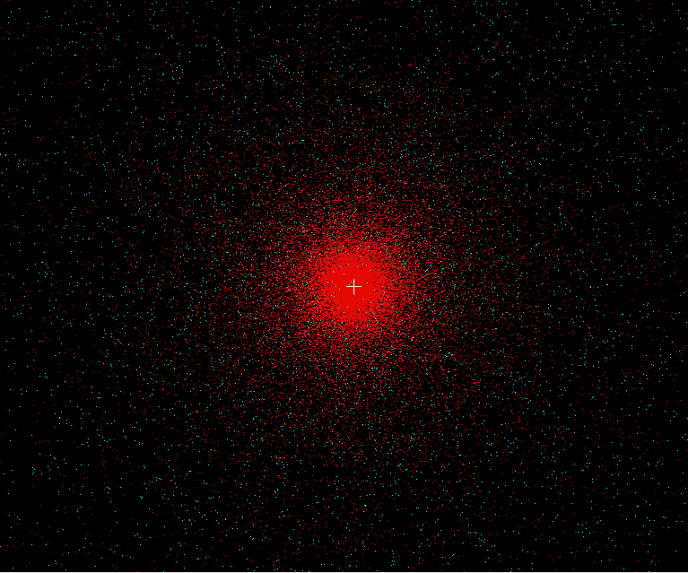
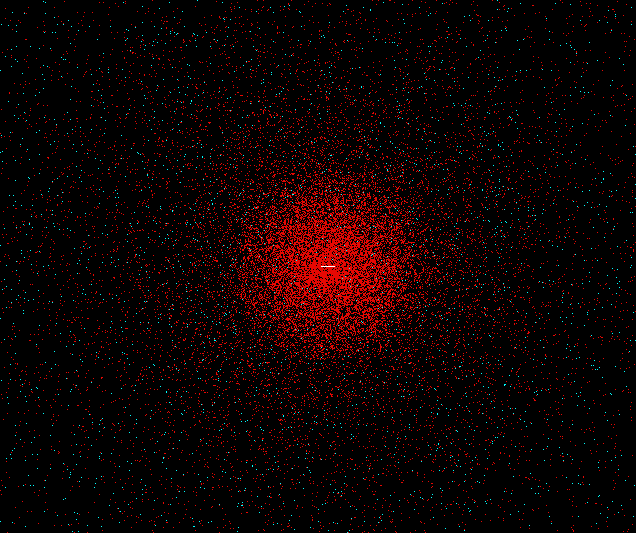
A visual example
20 Kpc
80% bary mass loss
Equilibrium before mass loss…
… and after mass loss
Red dots: baryons
White dots: DM
Notes:
Fare

Slide 8
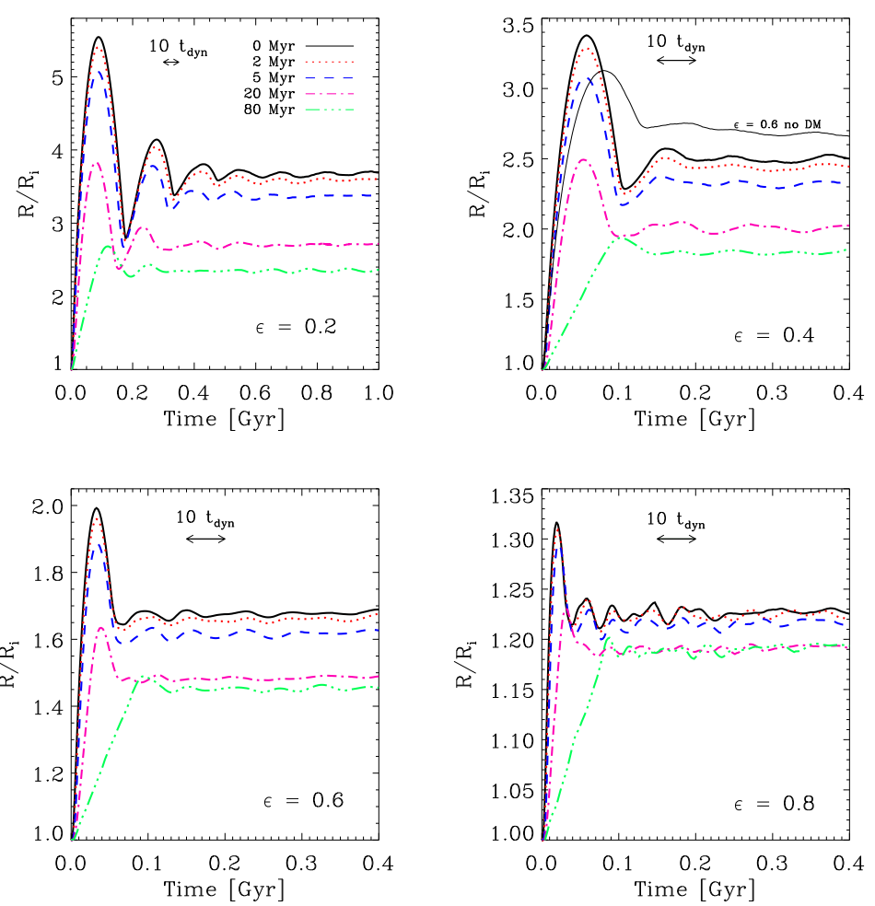
Size (R_{1/2} of stars) evolution

Slide 9
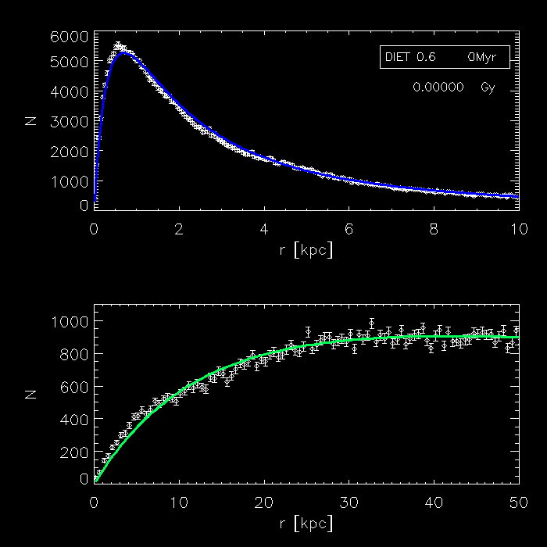
Effects on density profiles - (ε > 0.5)
In the fast regime, if (and only if) expulsion is “moderate” (ε > 0.5), after a transient very disturbed phase, baryons recover original functional form (Hernquist) , with larger scale –length: expansion;
As for DM, baryon expansion drags to some level DM particles, thus the final profile is always flattened in the very inner region wrt NFW
Bary
DM

Slide 10
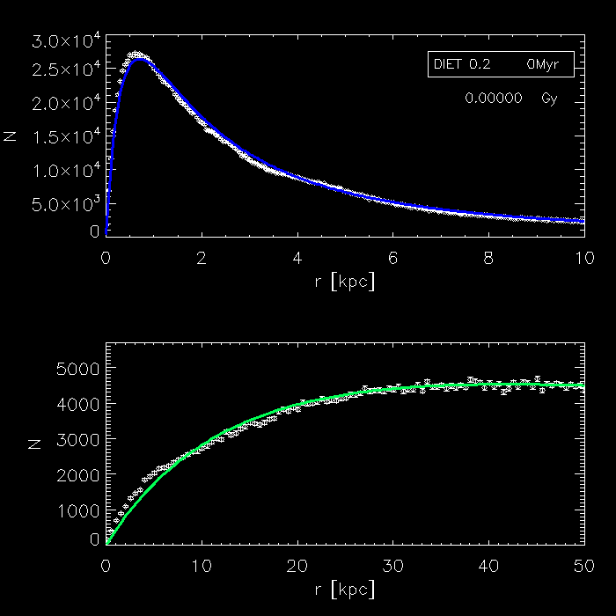
Effects on density profiles - (ε < 0.5)
Bary
if expelled fraction is dominating (ε < 0.5) baryons never recover original functional form (Hernquist)
Dark Matter
DM

Slide 11
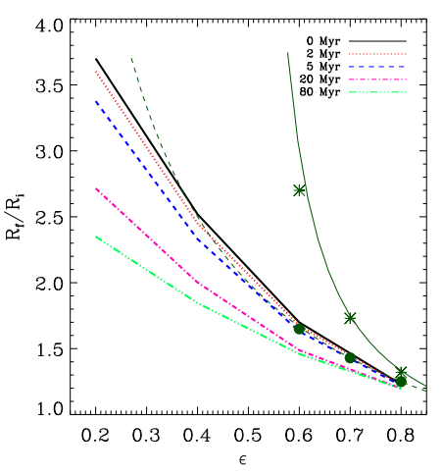
The final expansion factor
Test runs without DM confirm previous findings
DMH limits expansion and keeps bound the galaxy even if >80% of baryons are ejected
slower expulsion ) less expansion
Even with DMH included, conceivable to get “interesting” expansion factors » 2-3
Apparently ok to explain observed size evo, but….
M_{fin}/M_{ini}

Slide 12
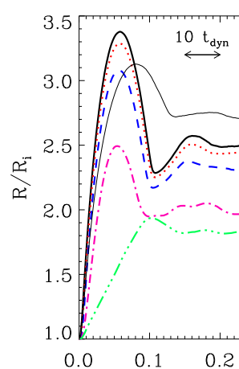


Puffing up by galactic winds cannot explain the observed size evolution
Expansion factor sufficient but..
Expansion occurs during » 20 Myr after the end of star formation (a few t_{dyn})
But high-z ETGs are observed still compact >0.5-1 Gyr after the end of star formation.
If any, signatures of this process in much younger systems
Residual gas expelled,
Star formation stops
Final size reached (and transiently surpassed)
But high-z ETGs observed still compact

Slide 13
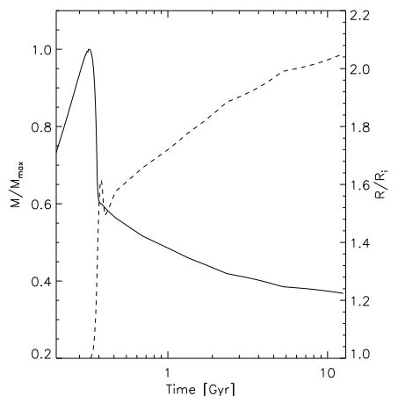
Size expansion for a specific SAM for SMBH-spheroid co-evolution, including AGN driven galactic wind and stellar evolution mass loss (Granato et al 2004)
Fast (30 Myr) expansion by a factor 1.6 just after SF termination due to galactic winds
Further secular expansion by another 20-30%, due to gas given back to gas phase by stellar evo, assuming not retained. Here details depends on IMF, stellar lifetimes and yields.
Size expansion
Baryonmass

Slide 14
DMHs in ellipticals: cuspy or cored?
A very general prediction of cosmological, gravity only, simulations is that DM haloes should have cuspy density profiles, independently of the mass scale.
At low to intermediate galactic scales (dwarfs, LSB, spirals) observations strongly suggest that the halos are instead cored.
Mismatch attributed to back-reaction of galaxy formation on DM, more than counteracting initial adiabatic contraction.
At cluster scales it’s unclear: since years, several claims for cores (e.g. Ricthler+ 2011) as well as for cusps (Zitrin+ 2011).
In between, ie. at the largest galactic scales (ETGs), studies are in infancy. A few very recent claims for cusps (e.g. Tortora+ 2010, Sonnenfeld+ 2011) as well as for cores (e.g. Memola+ 2011)

Slide 15
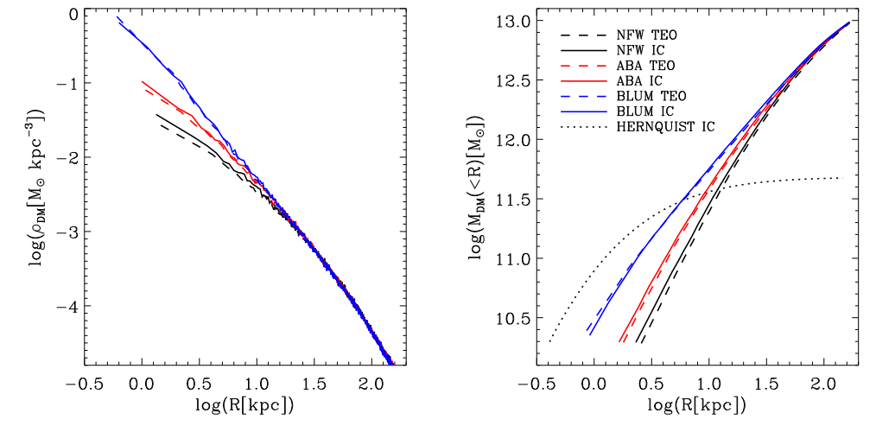
What happens to DM profiles: IC
We run also from Initial Conditions (IC) including adiabatic contraction according to various prescriptions

Slide 16
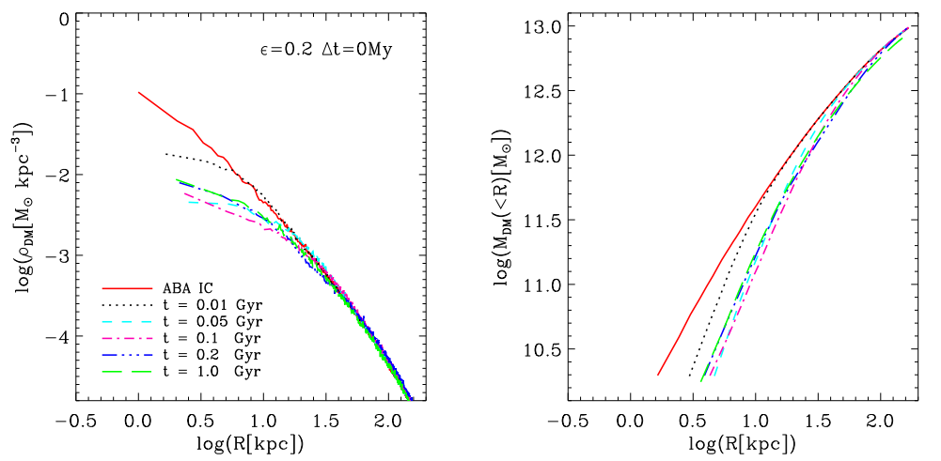
Sample time evolution
A few tens of dynamical times after baryon mass loss, a new equilibrium is reached, characterized by sizeable flattening within the effective radius if expelled fraction is important

Slide 17
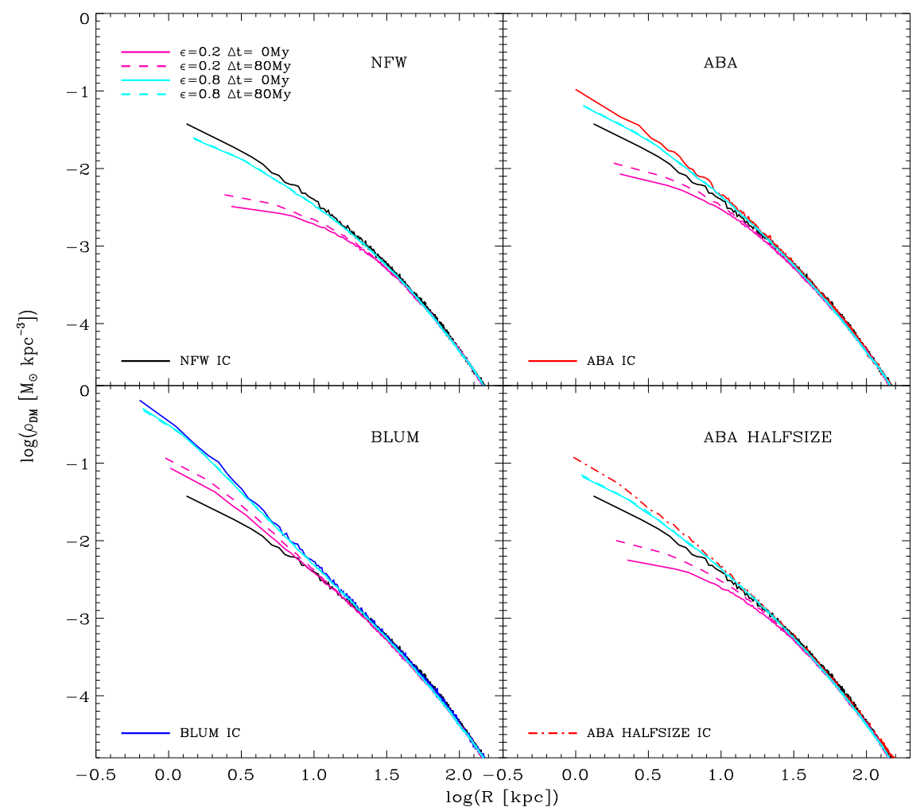
Dependence of final equilibrium on efficiency, timescale, and initial profile

Slide 18
For realistic adiabatic contraction, the final DMH profile is predicted to be substantially flatter than NFW
Claims for cuspy density proﬁles of DMH in ETGs could be diﬃcult to reconcile with an eﬀective AGN (or stellar) feedback during the evolution of these systems.

Slide 19
Summary
Observed size evolution still unclear. Minor dry mergers could do part, but likely not all, of the job, particularly at z>1 (Newman et al 2011).
But even puffing up due to galactic wind cannot explain size evolution of ETGs observed so far.
Nevertheless, the process is likely to occur and have a role in deciding final morphology of ETGs. But signatures should be searched for in much younger systems.
Puffing up due to stellar evolution mass loss may contribute, but not dominate, observed size evolution.
Possible tension between the idea of important AGN feedback and claims of cuspy DMH density profiles in elliptical galaxies.
In the future it could be of some interest:
  to investigate in detail the moderate expansion due to passive evolution of stellar populations (e.g. dependence on IMF etc);
  to evaluate how to catch in observations expansion due to galactic winds

